Slide 1
Digital Portfolio
STUDENT NAME: PRIYADHARSHINI R
REGISTER NO AND NMID: asanm12712724ubca0015
DEPARTMENT: II - BCA
COLLEGE: COLLEGE/ UNIVERSITY: JOHN DEWEY COLLEGE OF ARTS AND SCIENCE FOR WOMEN, PULAVANUR, PANRUTI, CUDDALORE – 607 205 / ANNAMALAI UNIVERSITY.

Slide 2
PROJECT TITLE
Portfolio for a Creative Web Designer
STUDENT PORTFOLIO FOR A
CREATIVE WEB DESIGNER

Slide 3


AGENDA
Problem Statement
Project Overview
End Users
Tools and Technologies
Portfolio design and Layout
Features and Functionality
Results and Screenshots
Conclusion
Github Link
3/21/2024 Annual Review

Slide 4

PROBLEM STATEMENT
In today's digital world, having a strong online presence is essential for individuals pursuing careers in creative fields such as web design. Many aspiring designers lack a well-structured and visually appealing portfolio to showcase their skills, projects, and personal brand. Without a professional digital portfolio, it becomes challenging to stand out in the competitive job market and connect with potential clients or employers.
This project aims to solve that problem by designing and developing a modern, responsive, and user-friendly personal portfolio website for Priyadharshini R, a creative web designer. The portfolio will serve as an online platform to highlight her skills, past projects, and personal information using modern HTML and CSS techniques, ensuring it is visually engaging, accessible, and mobile-friendly.

Slide 5

PROJECT OVERVIEW
This project involves the design and development of a personal portfolio website for Priyadharshini R, a creative and aspiring web designer. The website is intended to serve as a digital identity that presents her skills, experience, and project work in a clean, modern, and interactive manner.
Built using standard web technologies such as HTML5 and CSS3, the portfolio is fully responsive, ensuring optimal viewing across various devices including desktops, tablets, and smartphones. The site includes key sections such as a personal introduction, skillset, project highlights, and contact details, all organized within an aesthetically pleasing and intuitive layout.
Advanced CSS styling, animations, and layout techniques are used to enhance the visual appeal and user experience. The website not only demonstrates Priyadharshini's design capabilities but also functions as a live example of her front-end development skills — making it a powerful tool for career opportunities in the field of web design and development.

Slide 6

WHO ARE THE END USERS?
Potential Employers / Recruiters
They will visit the portfolio to evaluate Priyadharshini R’s web design skills, creativity, and experience before considering her for job roles, internships, or freelance opportunities.
Clients / Project Collaborators
Individuals or businesses looking to hire a web designer for freelance or collaborative projects may use the portfolio to assess design style, past work, and contact her directly.
Academic Evaluators / Faculty
In case this project is submitted for academic purposes, instructors or evaluators will be the end users reviewing the portfolio for grading or assessment of technical and design capabilities.

Slide 7

TOOLS AND TECHNIQUES
HTML5
For structuring the content of the website with semantic tags.
CSS3
For styling, layout, colors, fonts, animations, and responsive design.
Text Editor / IDE
Tools like Visual Studio Code (VS Code) for writing and managing code efficiently.
Web Browsers
For testing and previewing the website (e.g., Google Chrome, Firefox, Microsoft Edge).

Slide 8
POTFOLIO DESIGN AND LAYOUT
1. Overall Design Concept
The portfolio features a clean, modern, and minimalist design to highlight content clearly without distractions.
The color palette combines soft gradients with bright accent colors (like teal and cyan) to give a fresh, creative, and professional feel.
The typography uses readable sans-serif fonts for clarity and a friendly vibe.
2. Layout Structure
Header Section
Displays the profile picture prominently at the top center with a subtle animation for visual engagement.
Includes the designer’s name ("Priyadharshini R") and a brief tagline describing her role.
Background uses a bold accent color with white text for contrast.
About Me Section
A brief personal introduction written clearly to communicate the designer’s passion and approach.
Placed immediately below the header for a smooth flow.
8

Slide 9
FEATURES AND FUNCTIONALITY
1. Responsive Design
The portfolio automatically adjusts its layout and content to fit any device screen size, including desktops, tablets, and smartphones, ensuring an optimal user experience.
2. Profile Section with Animated Image
Displays a professional profile picture with a smooth pop-in animation on page load to capture attention.
Showcases your name (Priyadharshini R) and a brief tagline describing your role and expertise.
3. About Me Section
A concise introduction explaining who you are, your passion for web design, and your approach to creating user-friendly, modern websites.

Slide 10

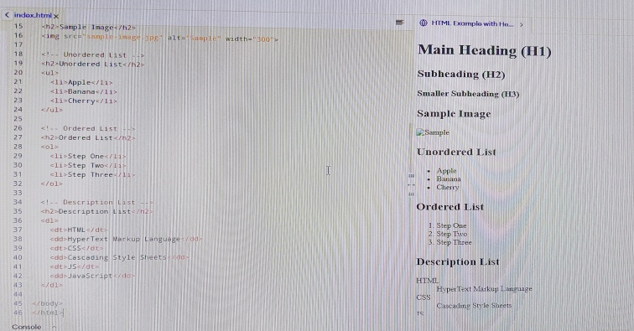
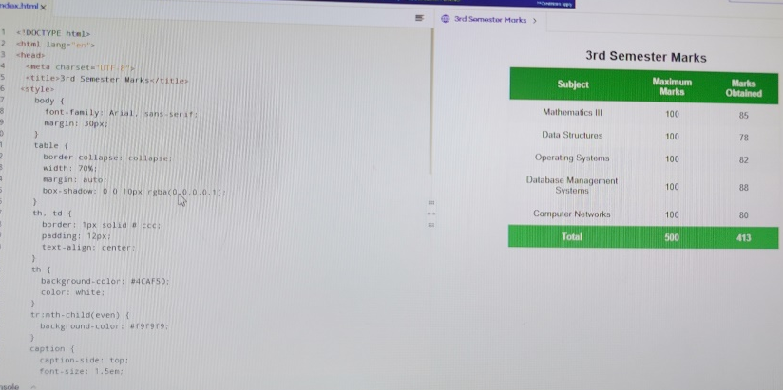
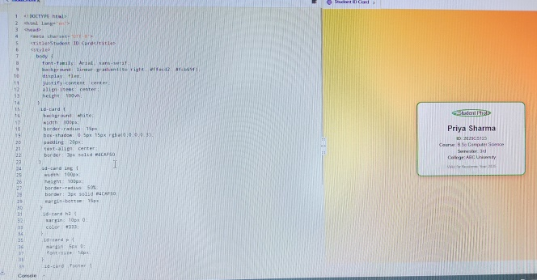
RESULTS AND SCREENSHOTS
The portfolio website successfully loads on various devices, including desktops, tablets, and smartphones, confirming its fully responsive design.
Smooth animations, such as the profile image pop-in and hover effects on skill and project cards, enhance the user experience.
Clear and visually appealing layout improves content readability and engagement.
3/21/2024 Annual Review
10

Slide 11
CONCLUSION
The development of this personal portfolio website for Priyadharshini R successfully demonstrates the application of modern web design principles using HTML5 and CSS3. The project highlights key skills, projects, and personal branding in a clean, responsive, and visually appealing manner.
By integrating responsive layouts, subtle animations, and an intuitive structure, the portfolio offers an engaging user experience across devices. This website not only serves as a professional showcase for potential employers and clients but also exemplifies proficiency in front-end web development and design.
Overall, the project fulfills its objective of creating a functional, attractive, and user-friendly platform that effectively communicates the designer’s creativity and technical expertise, establishing a strong foundation for future career growth in web design.
11

